Slide 1
NETWORK CONNECTIONS
A Network is a group of interconnected computers that are connected together

Slide 2
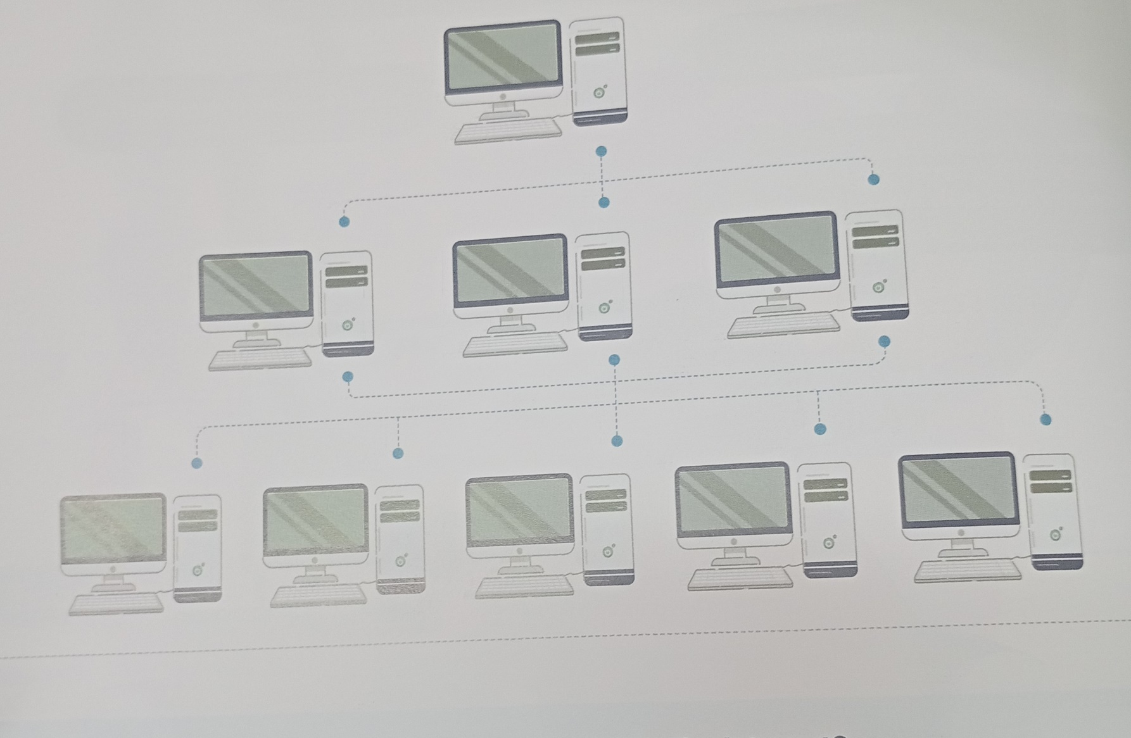
EXAMPLE

Slide 3
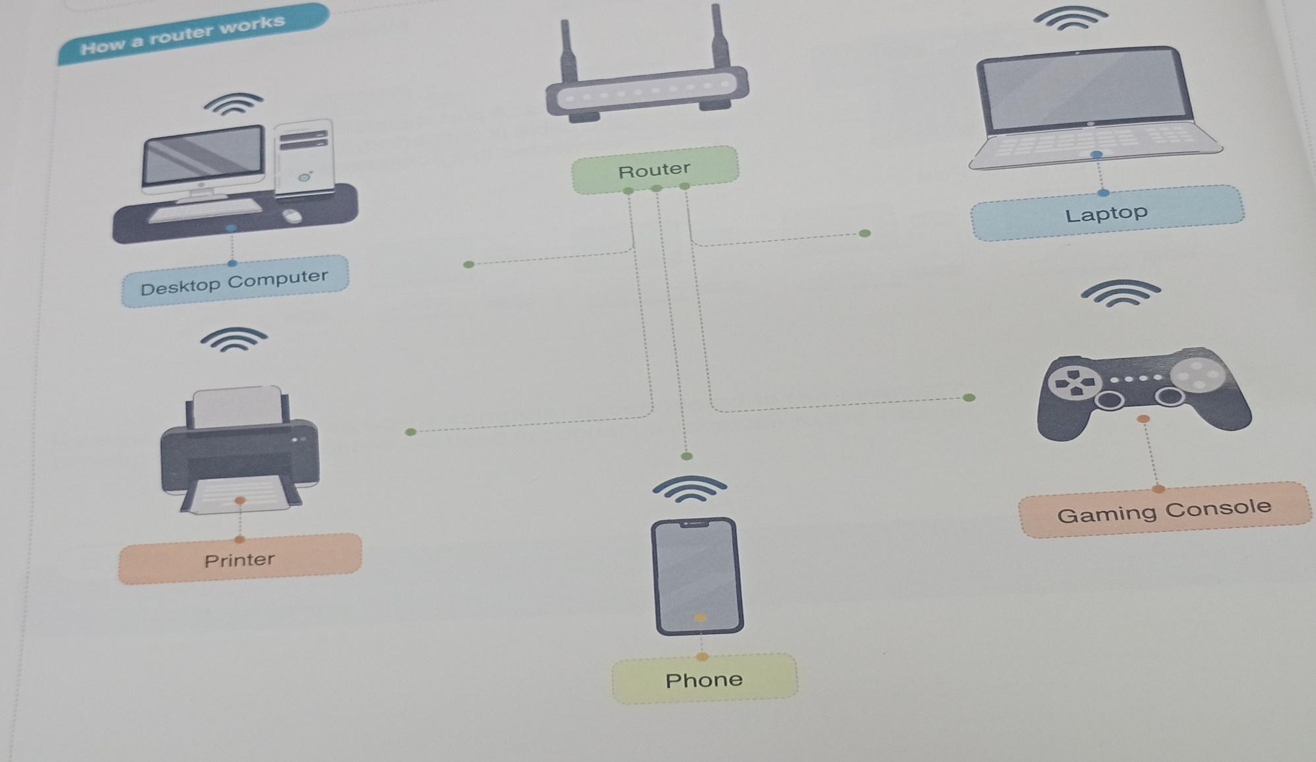
ROUTER

Slide 4
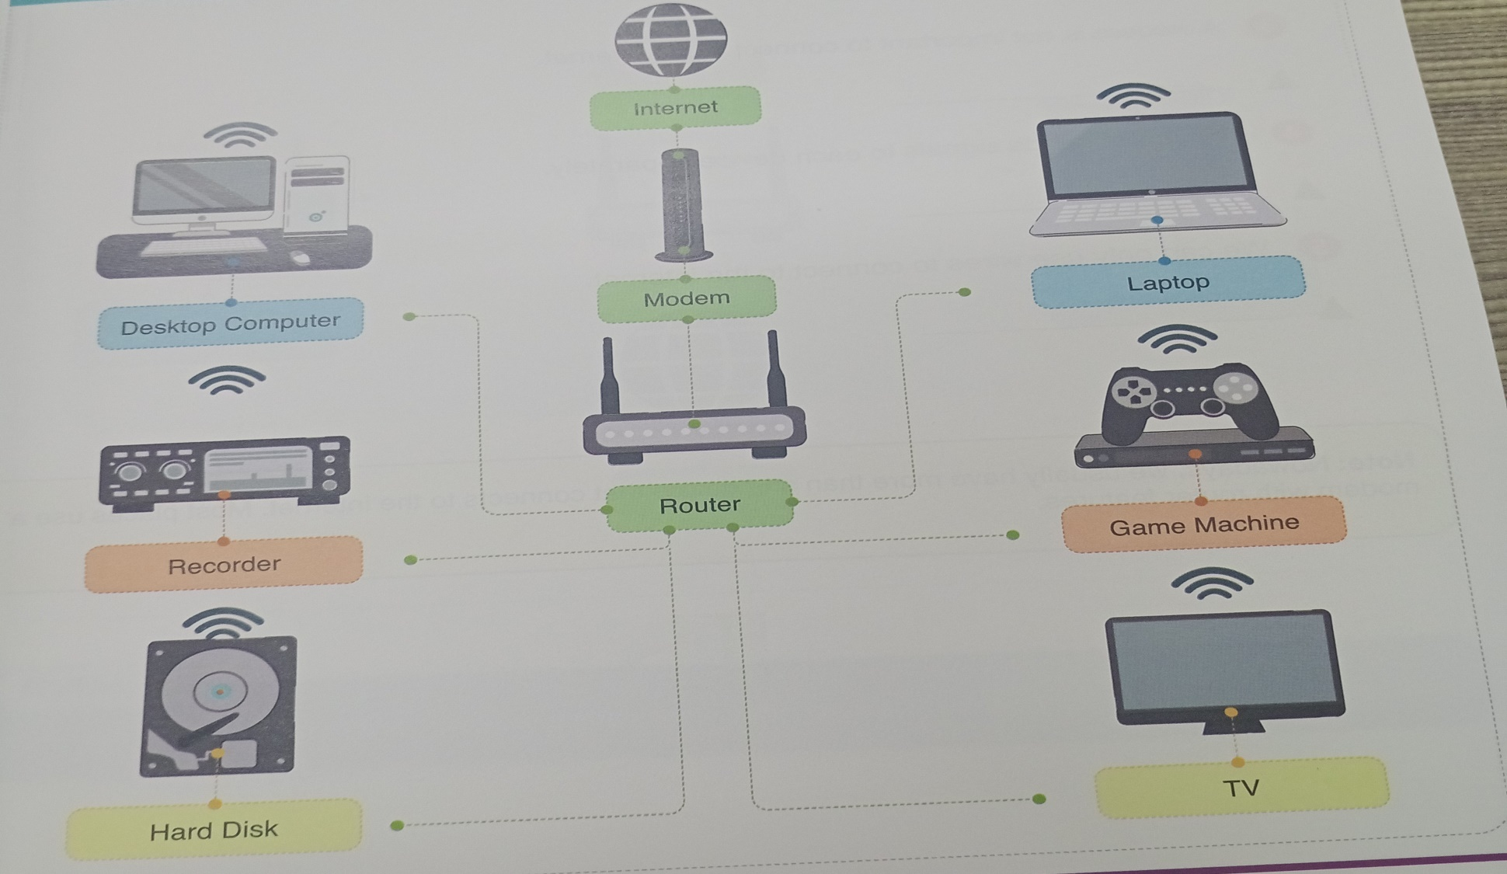
MODEM

Slide 5

LOCAL AREA NETWORK(LAN)
Is a network of interconnected computers

Slide 6
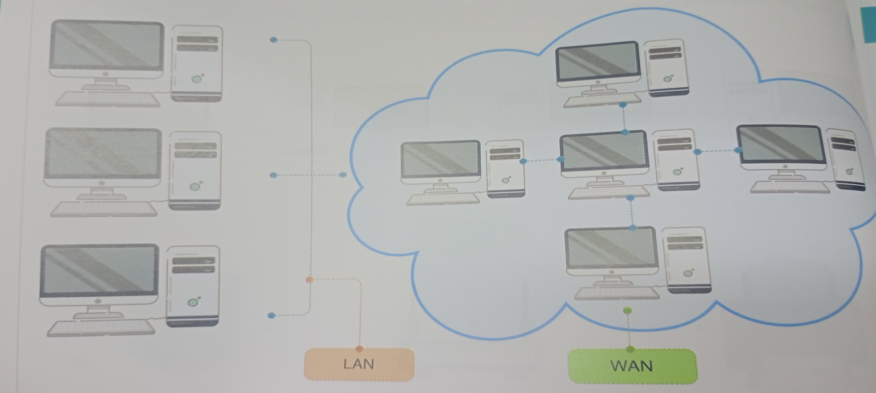
WIDE AREA NETWORK(WAN)
Is a network that connects many LAN together.

Slide 7
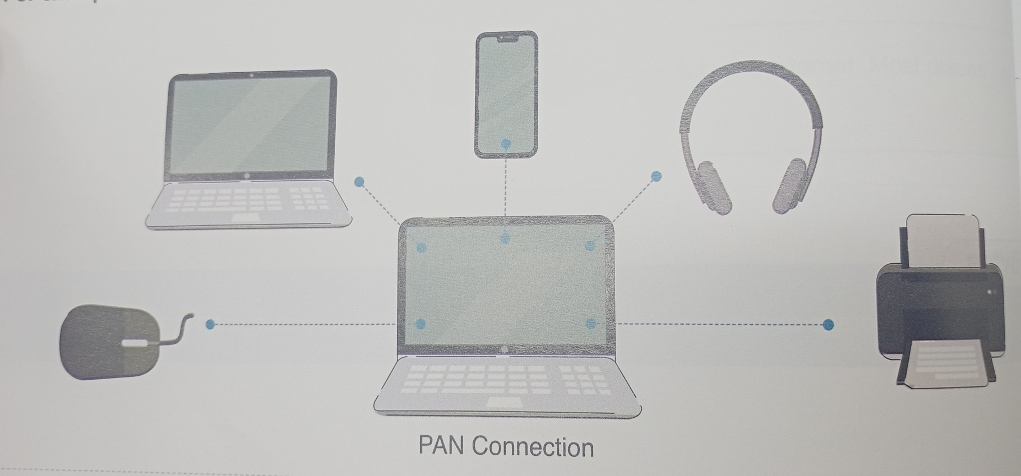
PERSONAL AREA NETWORK(PAN)
Is a network between devices that are used by a single person.

